Slide 1


Swarup Biswas
<Date>

Slide 2

Outline
Executive Summary
Introduction
Methodology
Results
Conclusion
Appendix

Slide 3
Executive Summary
We will employ several data analysis techniques, including Logistic Regression, Decision Tree, K-nearest Neighbor, and Support Vector Machine (SVM). These models will be trained on publicly available data related to SpaceX launches. We will also create interactive dashboards to visualize the predictions and provide actionable insights for our team.
The test results across various machine learning models were consistently similar, indicating uniform performance across the models. This consistency suggests that the data is well-structured and that the features are sufficiently informative for the models. The similar performance also highlights that our model selection and hyperparameter tuning processes have been effective in ensuring reliable results.

Slide 4
Introduction
This project addresses the rapidly growing space tourism industry, where companies like SpaceX are flourishing due to their cost-efficient rocket launches that make space travel more affordable and accessible to consumers. SpaceX has notably reduced operational costs for its Falcon 9 rocket launches through the reusability of the first-stage booster. Successful landings of the first stage are crucial, as they significantly lower excess launch costs and contribute to sustainable and economical space travel.
The primary objective of this project is to analyze SpaceX Falcon 9 rocket launches and develop a machine learning model that accurately predicts the likelihood of a successful first-stage landing. Achieving reliable predictions will enable SpaceY to estimate launch costs more precisely, optimize resource allocation, and maintain a competitive advantage in the burgeoning space tourism market.

Slide 5

Section 1

Slide 6
Methodology
Executive Summary
Data collection methodology:
Describe how data was collected
Perform data wrangling
Describe how data was processed
Perform exploratory data analysis (EDA) using visualization and SQL
Perform interactive visual analytics using Folium and Plotly Dash
Perform predictive analysis using classification models
How to build, tune, evaluate classification models

Slide 7
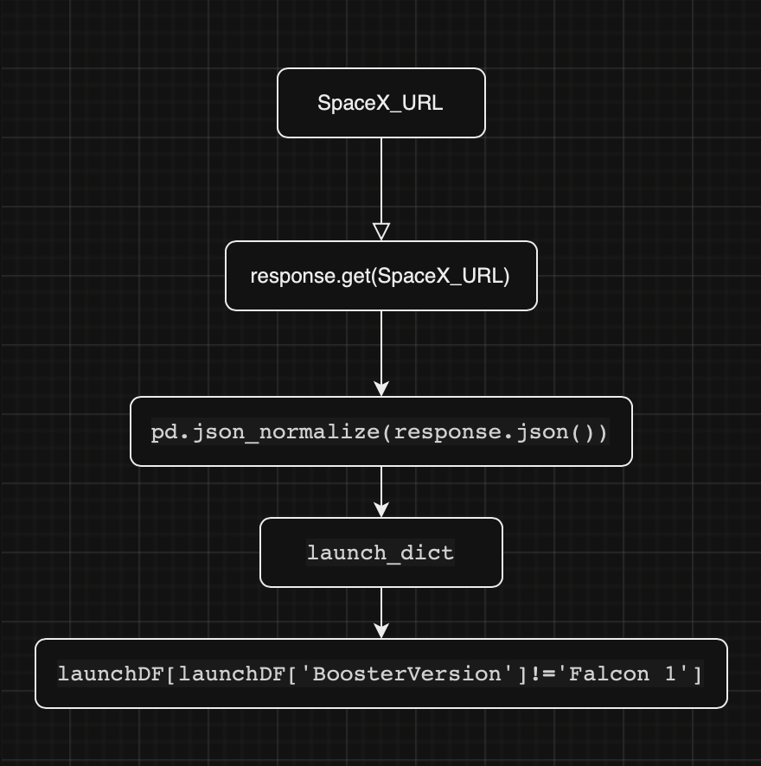
Data Collection – SpaceX API
https://github.com/Swampybedeveloping/Coursera-Data-Science-Capstone/blob/608245e48035701fd538cfa50c6b9a19d0254281/DataCollection_API.ipynb

Slide 8
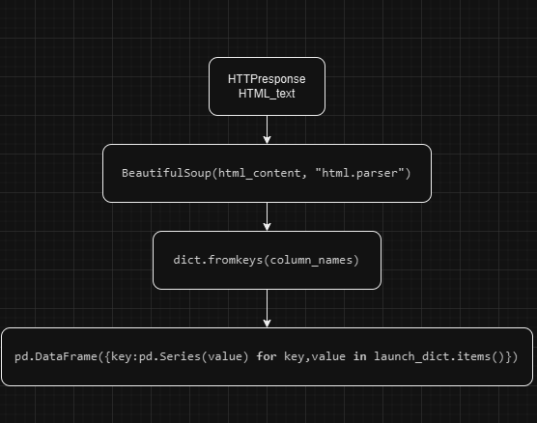
Data Collection - Scraping
https://github.com/Swampybedeveloping/Coursera-Data-Science-Capstone/blob/608245e48035701fd538cfa50c6b9a19d0254281/DataColleciton_WebScrapping.ipynb
Place your flowchart of web scraping here

Slide 9
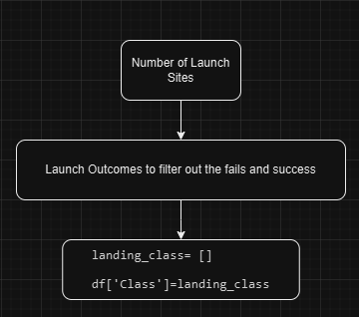
Data Wrangling
Added a additional column, “Class” that will help rate if the landing of stage 1 is successful or a failure
https://github.com/Swampybedeveloping/Coursera-Data-Science-Capstone/blob/608245e48035701fd538cfa50c6b9a19d0254281/DataWrangling.ipynb

Slide 10
EDA with Data Visualization
Category plots and bar graphs was used as we wanted to see how the different factors affected the outcomes of the landing with the 2 categories being, 0 for bad outcome and 1 for success.
https://github.com/Swampybedeveloping/Coursera-Data-Science-Capstone/blob/608245e48035701fd538cfa50c6b9a19d0254281/EDA_Visualisation.ipynb

Slide 11
EDA with SQL
Found the 4 different launch sites
Found the total Payload mass carried by the boosters on Falcon 9
Average Payload mass carried
First successful landing of stage 1
Found boosters that could land on drone ships and carried payload mass between 4000kg and 6000kg
Total successful and failed mission outcomes
Listed the boosters that carried the max payload mass
Listed the Failed Mission Outcome and Booster Version in the year 2015
Listed the count of all the success and failed landing from 04-06-2010 to 20-03-2017
https://github.com/Swampybedeveloping/Coursera-Data-Science-Capstone/blob/608245e48035701fd538cfa50c6b9a19d0254281/EDA_SQL.ipynb

Slide 12
Build an Interactive Map with Folium
Added circles to indicate the launch sites with each have markers
Red : Failed Outcome
Green: Successful Outcome
Added the distance from other nearby civilian sites to show the distance maintained to avoid inflicting on the residents of the state/town/city
https://github.com/Swampybedeveloping/Coursera-Data-Science-Capstone/blob/608245e48035701fd538cfa50c6b9a19d0254281/EDA_Folium.ipynb

Slide 13
Build a Dashboard with Plotly Dash
A pie chart that visualises the percentage of successful outcome to failed outcome
A scatter plot to show the different outcomes by the payload and booster version category.
This allows us to identify which launching site produces greater positive outcome and the booster version category to maximise successful outcomes.
https://github.com/Swampybedeveloping/Coursera-Data-Science-Capstone/blob/608245e48035701fd538cfa50c6b9a19d0254281/spacex_dash_app.py

Slide 14
Predictive Analysis (Classification)
Summarize how you built, evaluated, improved, and found the best performing classification model
Using Numpy dataframes, I tested the data sets against logistic regression models, decision trees, k-nearest Neighbours and Support Vector Machines to test and find the best performing classification model.
Grid Search CV was used to improve the model and find the model with the best parameters before finding the accuracy of each models to find the best model.
https://github.com/Swampybedeveloping/Coursera-Data-Science-Capstone/blob/046cc379deebff98160a8d009cad097fcb199e66/Predictive_Model.ipynb

Slide 15
Results
Success rate for outcome of the Falcom9 rocket launches has been positive and increment
The graphs can be viewed in terms of the launch sites as well as the rate of success, with KSC LC-40A having the highest success rate
Logistics Regression, Support Vector Model and K-nearest Neighbour can be used as predictive models to assume if a new Falcon9 rocket with a certain payload will have a successful land or a failure outcomes.

Slide 16

Section 2

Slide 17
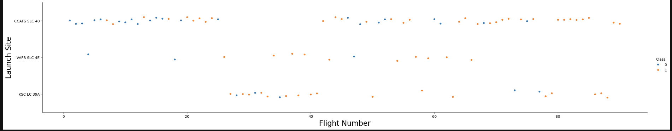
Flight Number vs. Launch Site
A Scatter plot of the launch site against the flight number to show that most of the launches occurred in launch site CCAFS SLC 40.

Slide 18
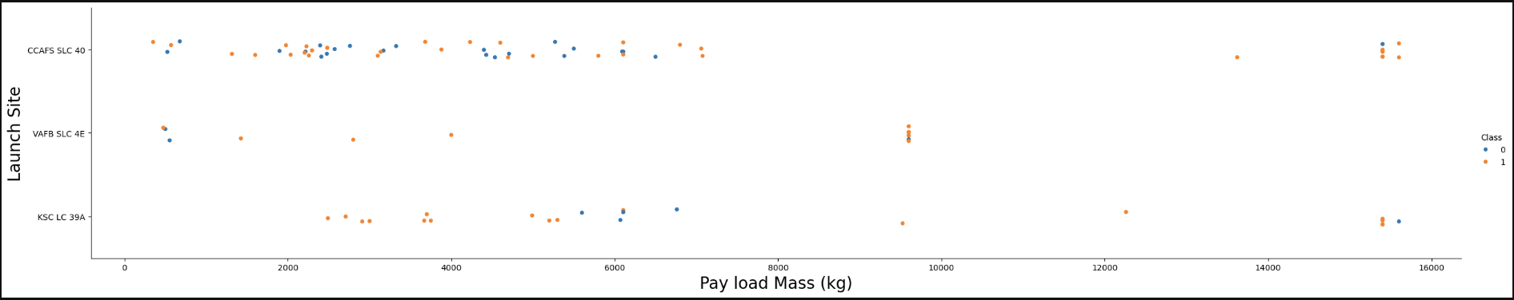
Payload vs. Launch Site
Most of the Payload is around 1000kg to 8000kg

Slide 19
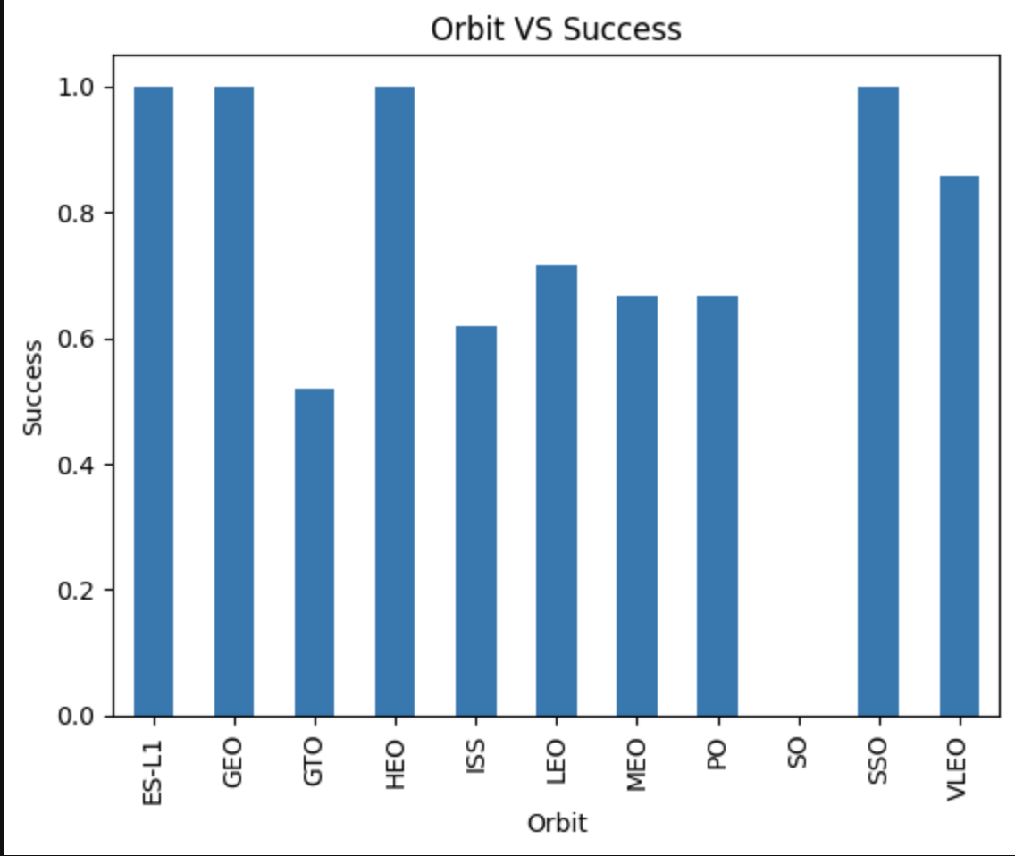
Success Rate vs. Orbit Type
Success rate is the highest in ES-L1, GEO, HEO, SSO and the lowest in S0 with a success rate of 0

Slide 20
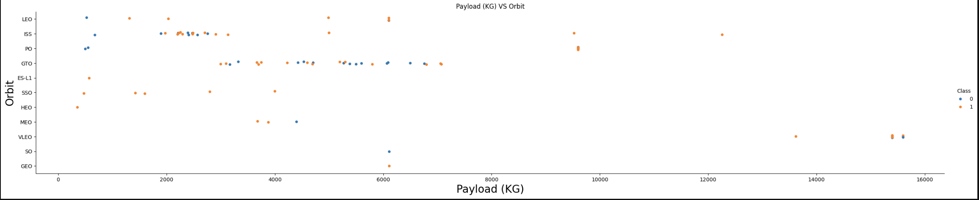
Payload vs. Orbit Type
Heaviest payloads reached the VLEO orbit and MEO while the lower payload rockets did not manage to reach orbit MEO, VLEO, SO and GEO

Slide 21
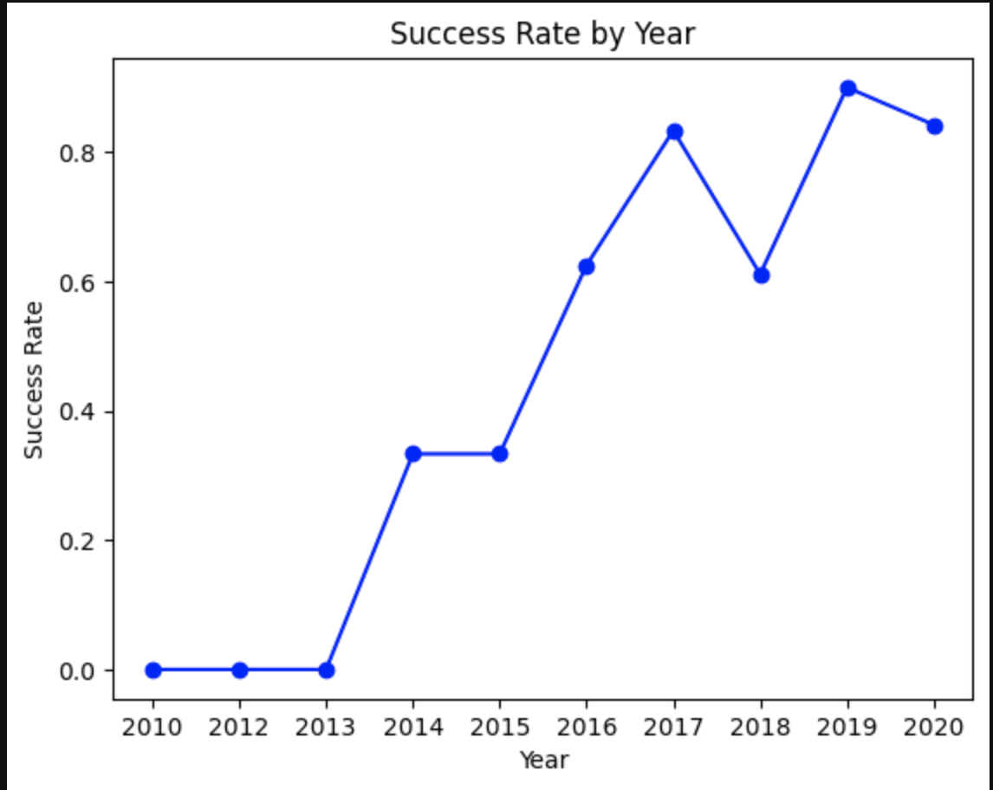
Launch Success Yearly Trend
The Success rate increased yearly to 2017 before dropping in 2017 to 2018 range and 2019 to 2020 range

Slide 22
All Launch Site Names
SELECT DISTINCT Launch_Site FROM SPACEXTABLE;
`DISTINCT` : returns values that appears in the column specified once, eliminating any duplicates
Site Names
CCAFS LC-40
VAFB SLC-4E
KSC LC-39A
CCAFS SLC-40

Slide 23
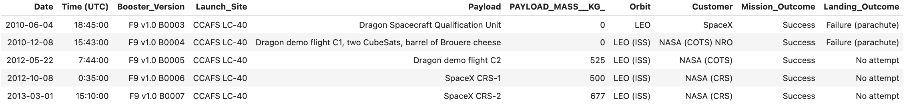
Launch Site Names Begin with 'CCA'
SELECT * FROM SPACEXTABLE WHERE Launch_Site LIKE "CCA%" LIMIT 5;
Top 5 results for launch sites names that begins with 'CCA' as there is a large number of data so if the first few data has 'CCA' in its name, it is more likely that the rest of the data will be the same.

Slide 24
Total Payload Mass
SELECT SUM(PAYLOAD_MASS__KG_) FROM SPACEXTABLE WHERE Customer = "NASA (CRS)";
SUM(): returns the total mass of the specified column(PAYLOAD_MASS_KG)
Total Paylaod Mass (kg)
45596

Slide 25
Average Payload Mass by F9 v1.1
SELECT AVG(PAYLOAD_MASS__KG_) FROM SPACEXTABLE WHERE Booster_Version LIKE "F9 v1.1%"
AVG(): returns the average mass of the specified column(PAYLOAD_MASS_KG)
AVG Paylaod Mass (kg)
2534.67

Slide 26
First Successful Ground Landing Date
SELECT MIN(Date) FROM SPACEXTABLE WHERE Landing_Outcome LIKE "Success (ground pad)";
MIN(): Finds the minimum value in the specified column(DATE)
which is the date of the first successful ground landing.
LIKE : allows to query through the column to find the successful ground landing
First Successful Landing Date
2015-12-22

Slide 27
Successful Drone Ship Landing with Payload between 4000 and 6000
SELECT DISTINCT Booster_Version FROM SPACEXTABLE WHERE Landing_Outcome = "Success (drone ship)" AND PAYLOAD_MASS__KG_ BETWEEN 4000 AND 6000;
DISTINCT : allows isolation of the booster versions without any duplicates to find the specifc booster versions that can land successfully
Booster Versions
F9 FT B1022
F9 FT B1026
F9 FT B1021.2
F9 FT B1031.2

Slide 28
Total Number of Successful and Failure Mission Outcomes
SELECT Mission_Outcome, COUNT(Mission_Outcome) FROM SPACEXTABLE GROUP BY Mission_Outcome;
GROUP BY: allows the different outcomes to be grouped together to allow easier counting of the total success and failure
Mission Outcomes
100 Success
1 Failure

Slide 29
Boosters Carried Maximum Payload
SELECT Booster_Version FROM SPACEXTABLE WHERE PAYLOAD_MASS__KG_ = (SELECT MAX(PAYLOAD_MASS__KG_) FROM SPACEXTABLE)
Used nested query to make sure the maximum payload is taken into account even when new data is added to the database
Booster Versions
F9 B5 B1048.4 F9 B5 B1049.4 F9 B5 B1051.3 F9 B5 B1056.4 F9 B5 B1048.5 F9 B5 B1051.4 F9 B5 B1049.5 F9 B5 B1060.2 F9 B5 B1058.3 F9 B5 B1051.6 F9 B5 B1060.3 F9 B5 B1049.7

Slide 30
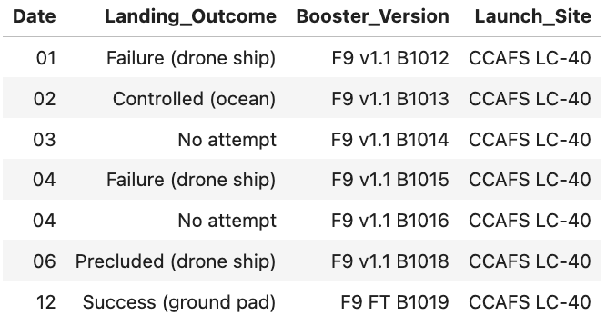
2015 Launch Records
SELECT substr(Date, 6,2), Landing_Outcome, Booster_Version, Launch_Site
FROM SPACEXTABLE
WHERE substr(Date,0,5)='2015' AND Landing_Outcome = "Failure (drone ship)"
Convert date to string before being used for comparision

Slide 31
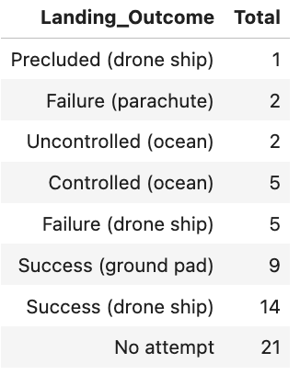
Rank Landing Outcomes Between 2010-06-04 and 2017-03-20
SELECT Landing_Outcome, COUNT(Landing_Outcome) AS Total FROM SPACEXTABLE GROUP BY Landing_Outcome HAVING Date BETWEEN "2010-06-04" AND "2017-03-20" ORDER BY COUNT(Landing_Outcome);

Slide 32

Section 3

Slide 33
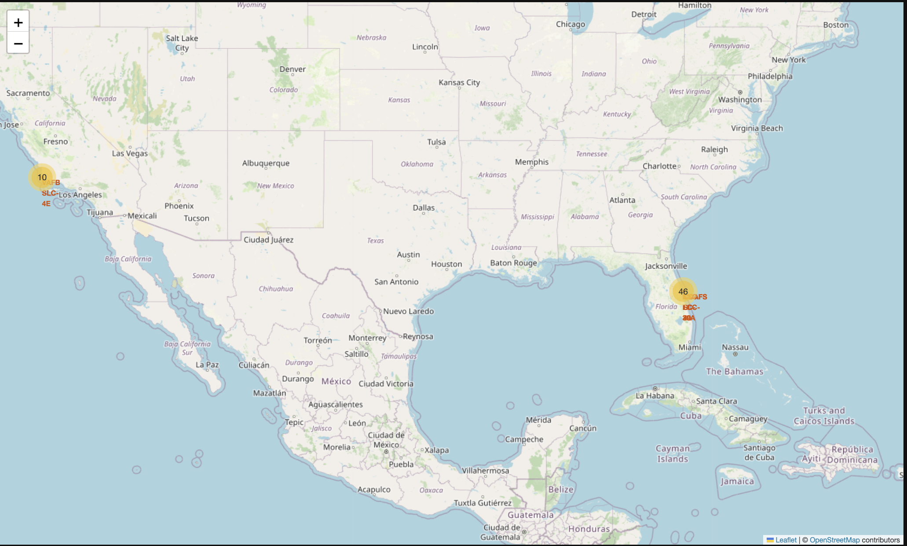
Launch Sites
All the launch sites are near the shores with large water bodies surrounding the area, away from civilisation and living spaces

Slide 34
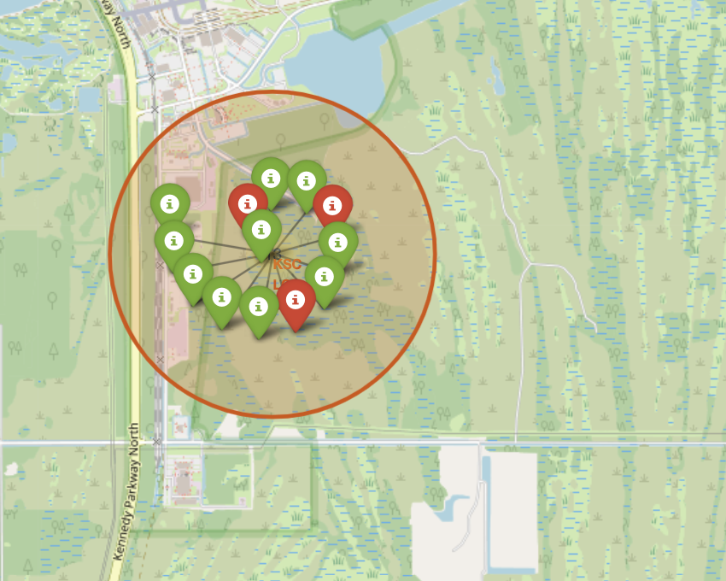
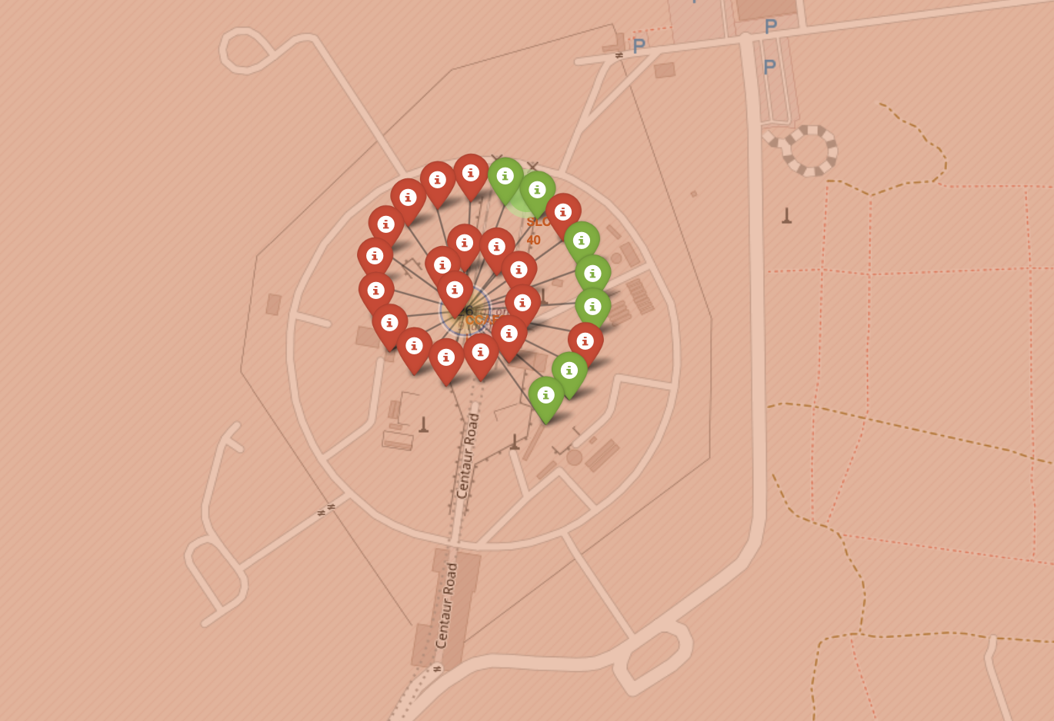
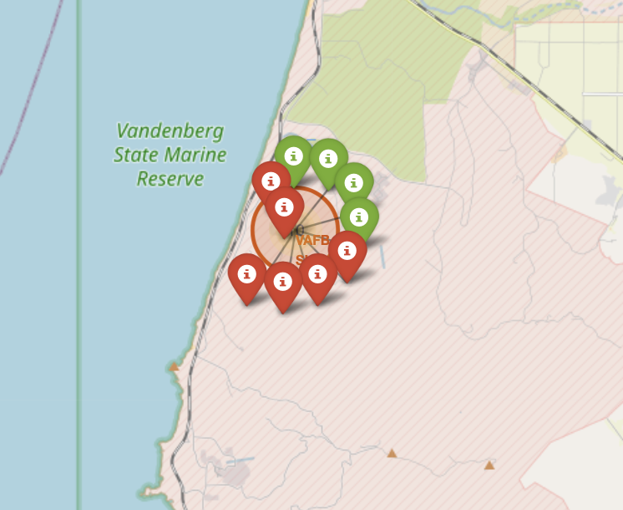
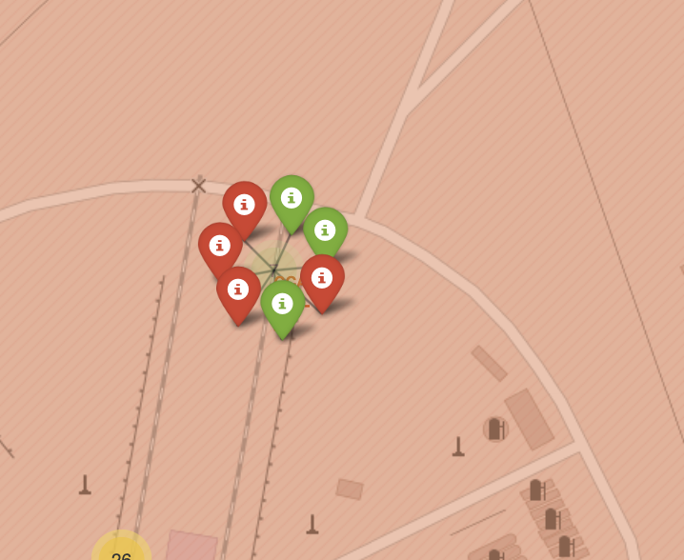
Successful VS Failed outcomes
The rate of successful outcomes is higher if the launches occur from launch sites that are more inland compared to those that are near the sea and/or large water bodies as shown by the many successful outcomes of launching site KSC LC-39A
KSC LC-39A
CCAFS LC-40
VAFB SLC-4E
CCAFS SLC-40

Slide 35
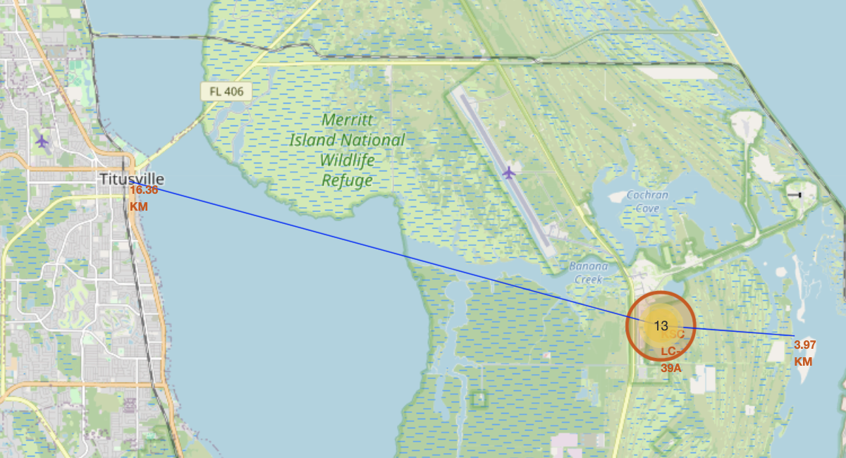
Launch Site Perimeter
Launch sites are located further away from Towns and Citites and closer to the shores
Launch Sites are also isolated and runways for aircrafts are always located within the vicinity

Slide 36

Section 4

Slide 37
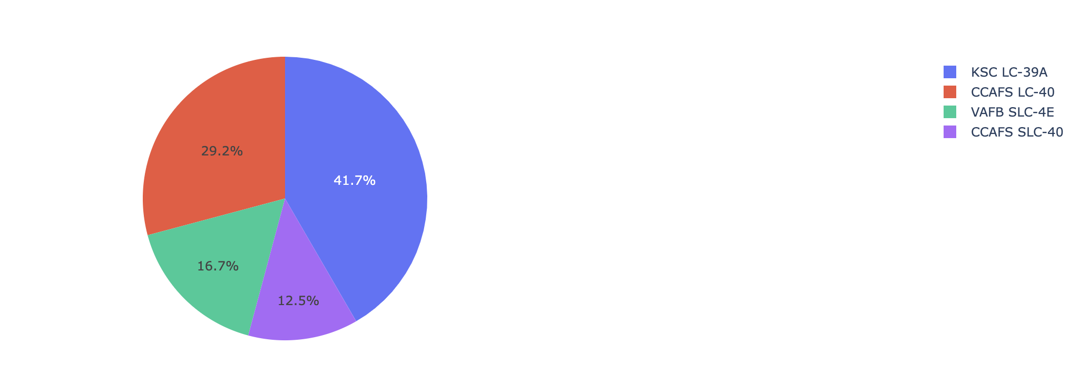
Launch Success Count
The Pie chart shows that the Launch Site, KSC LC-39A had the most successful launch at 41.7% compared to the other launch sites

Slide 38
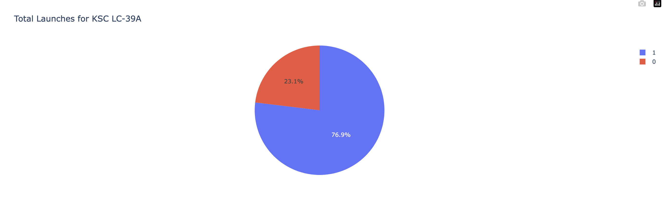
Most successful Launch site
KSC LC-39A had the most successful launches of Falcon9 Rockets with 76.9% Successful Outcome which is the highest amongst the other launch sites

Slide 39
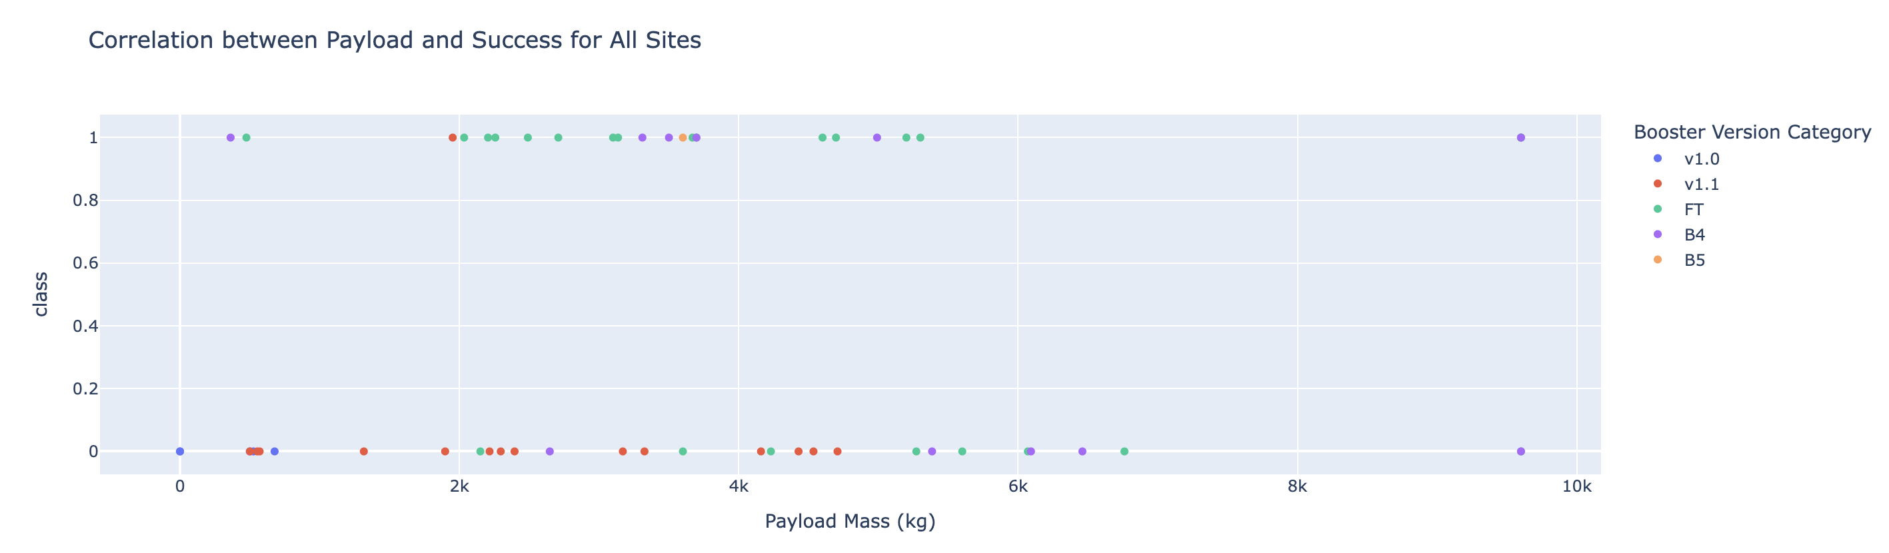
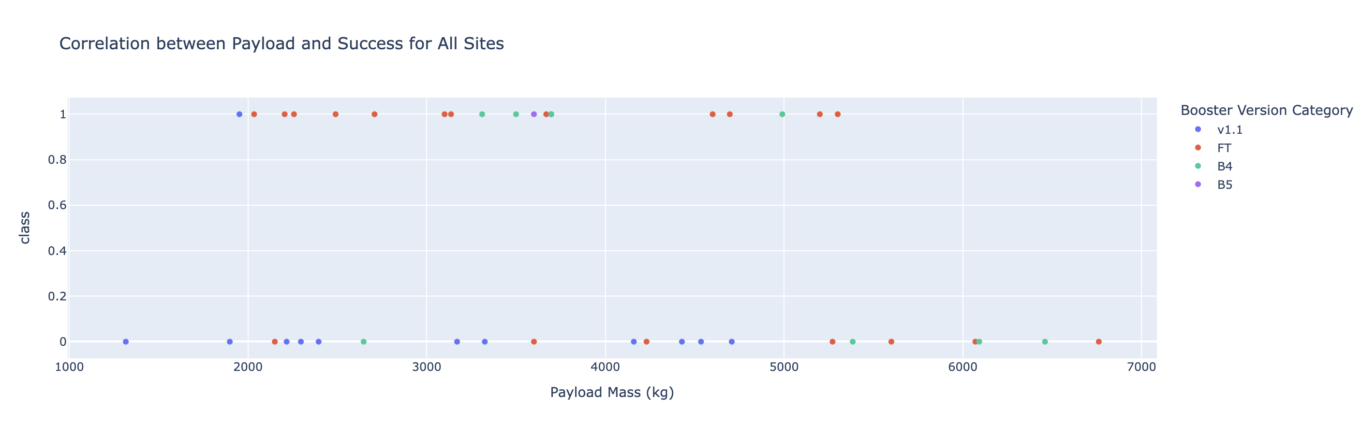
Payload With relation to Successful Outcome
Most of the launch ended up with a negative outcome lest some within the 1000kg to 600kg range
Amongst the successful launches, Booster Version FT performed the best with the most successful outcome.

Slide 40

Section 5

Slide 41
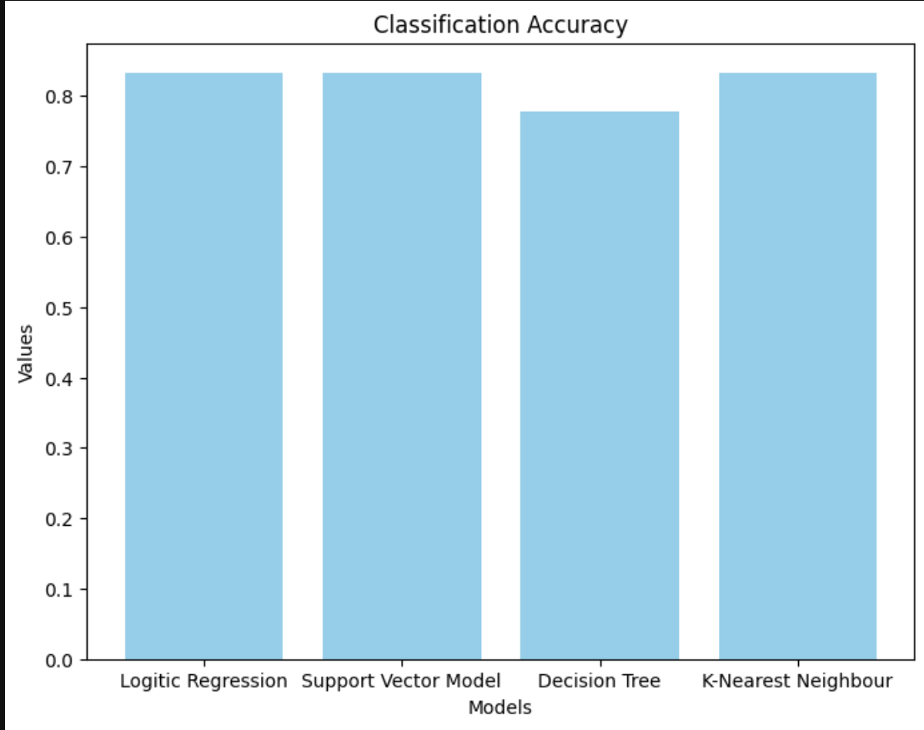
Classification Accuracy
Logistic Regression, Support Vector Model and K-nearest Neighbours are the most accurate models

Slide 42
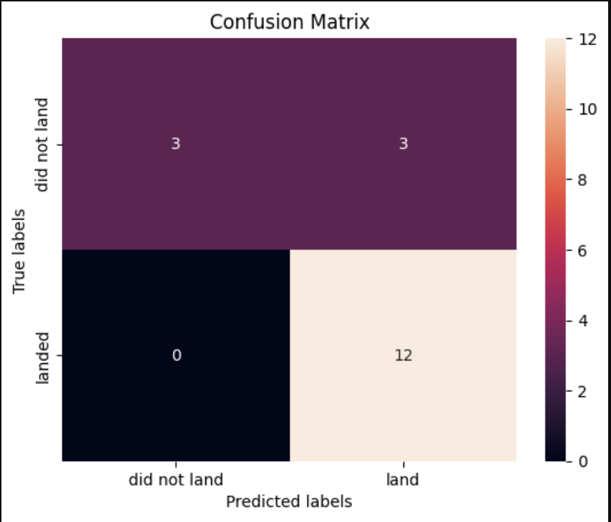
Confusion Matrix
Logistics Regression, Support Vector Model and K-nearnest neighbours all managed to accurately predict all the "landed" outcomes correctly and only half of the "did not land" outcomes correctly

Slide 43
Conclusions
KSC LC-39A had the highest success rate in the landing of stage 1of Falcon9 rockets
The data set is not big enough for a model to be accurately built as multiple models produces the similar accuracy score when run with test set.

Slide 44


